Slide 1
CSCI3170 Introduction to Database Systems
Tutorial 5 – Relational Algebra

Slide 2
Tut05 Outline
Recall
Examples
Classwork
Classwork answer

Slide 3
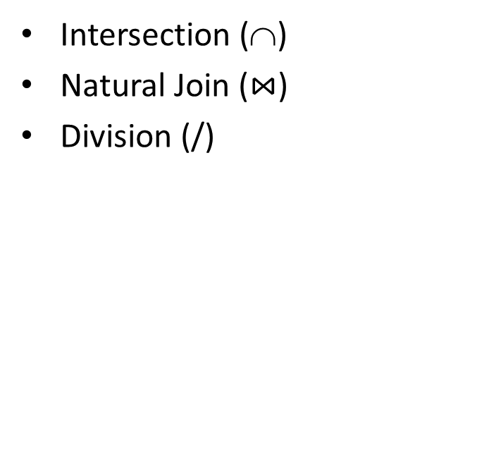
General Operators
Basic operators
Additional operators
Selection (σ)
Projection (Π)
Union (∪)
Set difference (–)
Cartesian Product (X)
Rename (ρ)

Slide 4
Selection (σ)
R2 := σ_{C} (R1)
C: selection condition
Logical connectives: and (∧), or (∨)
Comparison operators: <, ≤, =, ≠, >, ≥
Example: σ_{year>2}(S1)
sid | name | year | age
1 | Peter | 3 | 22
2 | John | 2 | 20
3 | Mary | 4 | 21
sid | name | year | age
1 | Peter | 3 | 22
3 | Mary | 4 | 21
S1

Slide 5
Projection (Π)
R2 := Π _{L} (R1)
L: a list of attributes from the schema of R1.
Example: Π_{name,age}(S1)
sid | name | year | age
1 | Peter | 3 | 22
2 | John | 2 | 20
3 | Mary | 4 | 21
name | age
Peter | 22
John | 20
Mary | 21
S1

Slide 6
Union (∪), Set difference (-), Intersection (∩)
S1 and S2 must be union-compatible
S1 ∪ S2: returns a relation instance containing all tuples that occur in either relation S1 or relation S2 (or both).
S1 - S2: returns a relation instance containing all the tuples that occur in S1 but not in S2.
S1 ∩ S2: returns a relation instance containing all tuples that occur in both S1 and S2.
5

Slide 7
Union (∪), Set difference (-), Intersection (∩)
S1 ∪ S2
sid | name | year | age
1 | Peter | 3 | 22
2 | John | 2 | 20
3 | Mary | 4 | 21
4 | David | 3 | 22
sid | name | year | age
1 | Peter | 3 | 22
2 | John | 2 | 20
3 | Mary | 4 | 21
S1
S1 - S2
sid | name | year | age
2 | John | 2 | 20
3 | Mary | 4 | 21
4 | David | 3 | 22
sid | name | year | age
1 | Peter | 3 | 22
S1 ∩ S2
sid | name | year | age
2 | John | 2 | 20
3 | Mary | 4 | 21
S2
S1 ∩ S2 = S1 – (S1 – S2)
6
Notes:
Union first combine the two table, then remove the duplicate. The result of the set difference contains the tuples appears in the S1 but not in the S2. The result of the intersection contain the tuple appear in both S1 S2

Slide 8
Cartesian Product (X)
R3 := R1 X R2
Pair each tuple t1 of R1 with each tuple t2 of R2.
Concatenation t1t2 is a tuple of R3.
Example: R1 X R2
A | B
a1 | b1
a2 | b2
R1.A | R1.B | R2.B | R2.C
a1 | b1 | b1 | c1
a1 | b1 | b2 | c2
a2 | b2 | b1 | c1
a2 | b2 | b2 | c2
R1
B | C
b1 | c1
b2 | c2
R2
Notes:
First we pick the first tuple in the R1, combine it with all the tuple in R2. We can see that the first two tuple in the new table are come from this way.

Slide 9
Join ( )
R3 := R1 _{C} R2
Take the product R1 × R2, then apply σ_{C} to the result.
R1 _{C} R2 = σ_{C} (R1 X R2)
Example: S _{S.sid <R.sid} R
sid | sname | rating | age
22 | Dustin | 7 | 45.0
31 | Lubber | 8 | 55.5
58 | Rusty | 10 | 35.0
sid | bid | day
22 | 101 | 10/10/96
58 | 103 | 11/12/96
S
R
S.sid | sname | rating | age | R.sid | bid | day
22 | Dustin | 7 | 45.0 | 58 | 103 | 11/12/96
31 | Lubber | 8 | 55.5 | 58 | 103 | 11/12/96
Notes:
Only two tuple in the new table are sactisfy the condition

Slide 10
Equi-join and Natural join
Equi-Join: A special case of condition join where the condition c contains only equalities.
Natural Join: Equi-join on all common fields.
Example: S R
sid | sname | rating | age
22 | Dustin | 7 | 45.0
31 | Lubber | 8 | 55.5
58 | Rusty | 10 | 35.0
sid | bid | day
22 | 101 | 10/10/96
58 | 103 | 11/12/96
S
R
sid | sname | rating | age | bid | day
22 | Dustin | 7 | 45.0 | 101 | 10/10/96
58 | Rusty | 10 | 35.0 | 103 | 11/12/96

Slide 11
Division (/)
A / B
Consider that A has two fields x and y. B has one field y, with the same domain as in A. (In general, x and y can be any lists of fields; y is the list of fields in B, and x ∪ y is the list of fields of A)
The division operation A/B is the set of all x values such that for every y value in a tuple of B, there is a tuple <x,y> in A.
Another understanding: for each x value in A, consider the set of y values that appear in tuples of A with that x value. If this set contains all y values in B, the x value is in the result of A/B.
Disqualified tuples:

Slide 12
Division (/)
Example: A / B
x | y
x2 | y1
x1 | y1
x2 | y2
x2 | y3
x1 | y2
x3 | y1
x | y
x1 | y1
 | y2
x2 | y1
 | y2
 | y3
x3 | y1
x
x1
x2
A
y
y1
y2
Group the rows based on the attribute(s) other than y
B

Slide 13
Rename (ρ)
ρ(T1,S1) or ρ(T1(F),S1)
F is called the renaming list:
oldname or position → newname
e.g. ρ(T1(name → firstname),S1)
sid | name | year | age
1 | Peter | 3 | 22
2 | John | 2 | 20
3 | Mary | 4 | 21
sid | firstname | year | age
1 | Peter | 3 | 22
2 | John | 2 | 20
3 | Mary | 4 | 21
S1
T1

Slide 14
Use of rename operator
Store the temporary result for later use
e.g. ρ(T1, σ_{year>2}(S1))
Compare the tuples in the same relation
e.g. ρ(T1, S1)
ρ(T2, S1)
σ_{T1.age > T2.age} (T1 × T2)

Slide 15
Remarks
There is no aggregate function in relational algebra
There is no operator for partial matching
Queries written in relational algebra can be expressed by SQL
Queries written in SQL may not be expressed by relational algebra

Slide 16
Examples
Consider the following relations containing airline flight information:
Note that the Employees relation describes pilots and other kinds of employees as well; every pilot is certified for some aircraft (otherwise, he or she would not qualify as a pilot), and only pilots are certified to fly.
Flights(aid, from, to, distance, departs, arrives)
Aircraft(aid, aname, cruisingrange)
Certified(eid, aid)
Employees(eid, ename, salary)

Slide 17
Query 1
Flights(aid, from, to, distance, departs, arrives)
Aircraft(aid, aname, cruisingrange)
Certified(eid, aid)
Employees(eid, ename, salary)
Find the eids of pilots certified for some Boeing aircraft.
Sol1: π_{eid}(σ_{aname=‘Boeing’} (Aircraft Certified))
Sol2: π_{eid}((σ_{aname=‘Boeing’} Aircraft) Certified)

Slide 18
Query 2
Flights(aid, from, to, distance, departs, arrives)
Aircraft(aid, aname, cruisingrange)
Certified(eid, aid)
Employees(eid, ename, salary)
Find the aids of all aircraft that can be used on non-stop flights from New York to Los Angeles.
ρ(NYToLA, σ_{from=‘New} _{York’ ∧ to=‘Los Angeles’}(Flights))
π_{aid}(σ_{cruisingrange>distance}(Aircraft × NYToLA))

Slide 19
Query 3
Flights(aid, from, to, distance, departs, arrives)
Aircraft(aid, aname, cruisingrange)
Certified(eid, aid)
Employees(eid, ename, salary)
Find the names of pilots who can operate planes with a range greater than 3,000 miles but are not certified on any Boeing aircraft.
ρ(R1, π_{eid}(σ_{cruisingrange>3000} Aircraft Certified))
π_{ename}(Employees (R1 − π_{eid}(σ_{aname=‘Boeing’} Aircraft
Certified)))

Slide 20
Query 4
Flights(aid, from, to, distance, departs, arrives)
Aircraft(aid, aname, cruisingrange)
Certified(eid, aid)
Employees(eid, ename, salary)
Find the eids of employees who are certified for the largest number of aircraft.
This query can NOT be expressed in relational algebra because there is no operator to count.

